Slide 1
Nextgen ReSharper

Slide 2
Purpose
Convert Stored Procedure to C# Code

Slide 3
Stored Procedure
C# Code
Idesign Pattern
Parameters
Model
Data Access
Business Logic
Engine
Select SQL Query 1
Business Logic
Call GetMethod1()
Update SQL Query 2
Insert SQL Query 3
Call UpdateMethod2()
Business Logic
Call InsertMethod3()

Slide 4
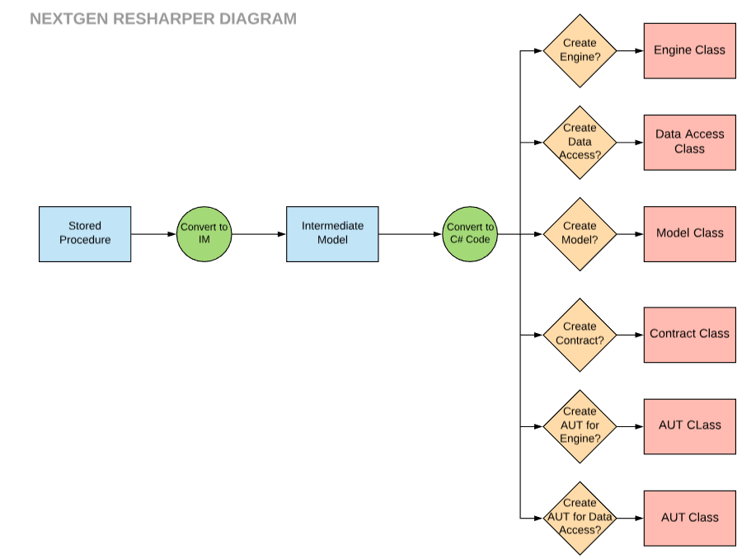

Slide 5
Technical
WPF with MVVM pattern
Using Nextgen.Data to create Data access
Following Idesign pattern
Using AutoFac IOC with BootStrapper
Implemented Async execution of code

Slide 6
Demo

